Slide 1

Capstone Project
Brooklyn, NY Venues

Slide 2

Introduction
I wanted to leverage FourSquare to find various venues around Brooklyn, NY neighborhoods. I will be using this information for an upcoming business conference that is going to be conducted near there. This information will help find places to take prospective future business associates as well as create connections across various companies.

Slide 3
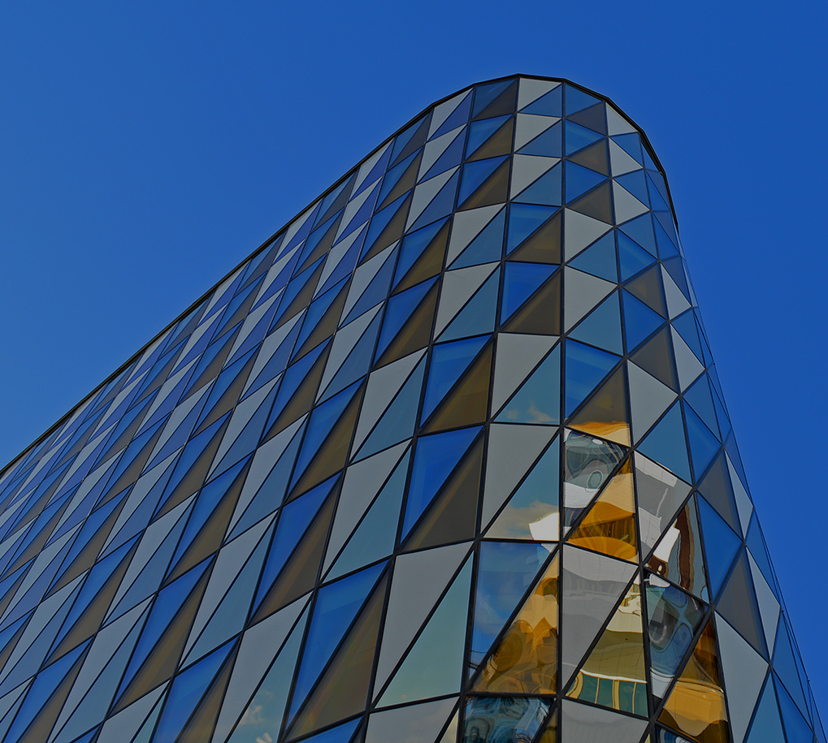
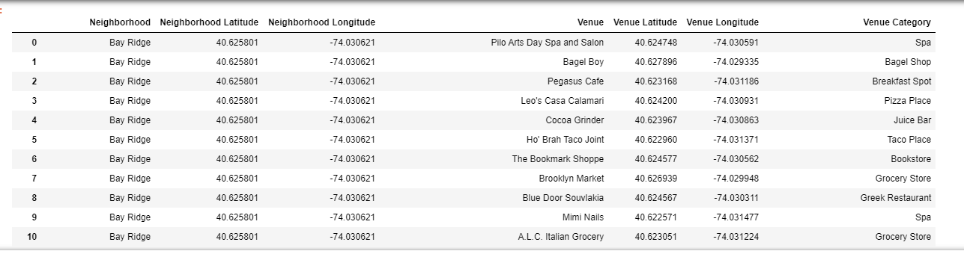
Methodology
FourSquare and Python
First we grab Brooklyn data that contains latitude and longitude neighborhood information in order to merge it with venue information from Foursquare

Slide 4
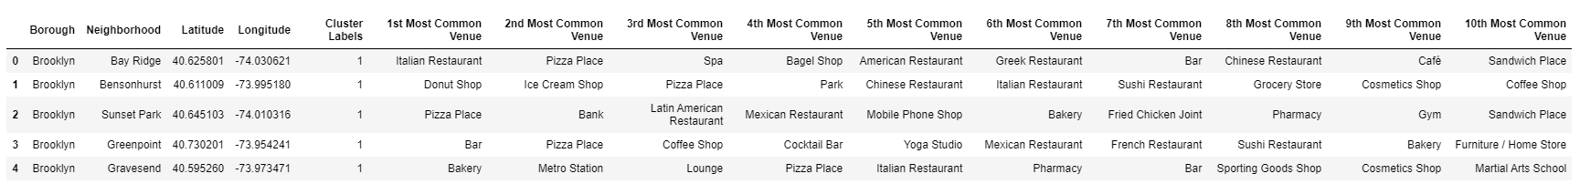
Methodology cont.
Cleaning, organizing and grouping data
We need to group and organize so we can apply K-means Clustering and add them to be mapped.

Slide 5
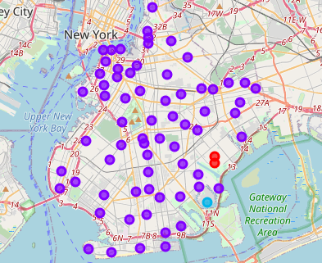
Results
Apply the Clustering to the map to view the results

Slide 6
Conclusion
In Conclusion, this has given me a list of possible places to take business associates, view on my own or even suggest places to others with the help of Foursquare and Python.

